Slide 1
FINANCIAL ANALYSIS
Name of team: Team Blue
Name of Mentor: Pravindra Kumar Gole
Team Members: 1. Kamutam Sai Nandu
2. Chinthapula Sharath Kumar
3. Kotha Vishwak
4. Kanneganti Neharsha Vishnu
5. Kamparaju Siddharth
6. Janjanam Nithin Teja
Team Lead: Kamutam Sai nandu

Slide 2
State of the Art
FINANCIAL ANALYSIS
Introduction
The number of dead pooled startups, or companies that shutdown or were pushed to the brink of a shutdown, stood at 34,848 in 2023, as per Tracxn, a private markets data provider. In 2022, there were 18,049 startups in the same category
What might be the reason for that? Well it depends . But we’ve also uncovered some more extraordinary causes of failure, those include poor financial management, financial frauds and lack of innovation.
Recently in Bengaluru a company had to shutdown due to the high beverages and coffee cost of their employees, on which they were spending unknowingly

Slide 3
Financial management is crucial for a company for several reasons:
1. Planning and Forecasting: It helps in setting realistic financial goals and creating a roadmap to achieve them. By forecasting revenues and expenses, a company can anticipate financial needs and plan accordingly.
2. Resource Allocation: Effective financial management ensures that resources (such as capital, equipment, and labor) are efficiently allocated to maximize productivity and profitability.
3. Risk Management: It involves identifying and managing financial risks such as market volatility, interest rate changes, credit risks, and operational risks. Proper management can reduce the impact of these risks on the company's financial health.
4. Decision Making: Financial data provides insights into the financial health of the company, enabling informed decision-making by management. It helps in evaluating investment opportunities, pricing strategies, cost management, and expansion plans.

Slide 4
5. Profitability and Sustainability: Ultimately, effective financial management aims to enhance profitability and ensure the long-term sustainability of the company. It helps in achieving financial stability and resilience in the face of economic challenges.
While there are some existing technologies in financial analysis which include financial modeling software (Excel, Python), data analytics tools (Tableau, Power BI), AI for predictive analytics, blockchain for decentralized finance, RPA for automation, cloud computing (AWS, Azure), quant tools (Bloomberg), RegTech for compliance, and financial APIs technologies optimize analysis, security, and decision-making in finance. But none of them provide a simple and understandable graphical interface.
That is where this project Financial Analysis comes in, While there are some companies in the market to provides financial analysis viz SAP , they might not be affordable for small scale business . Unlike them this project will provide a affordable web application to figure out where the resources of the company are utilized and which department is spending more and generating revenue. Ultimately which shows whether the company is running in Profits or Loss

Slide 5
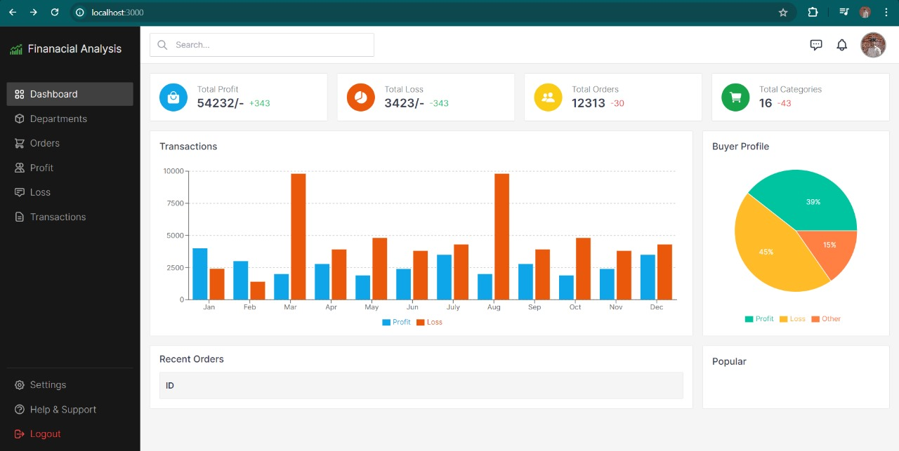
Customised UI/UX Design

Slide 6


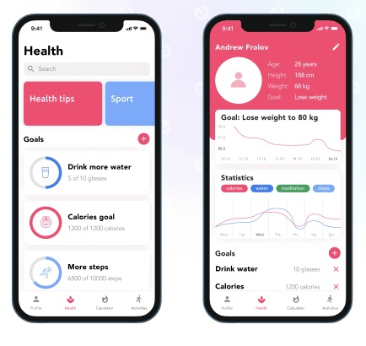
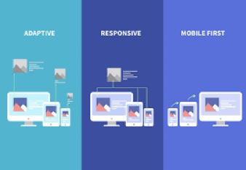
Growth of UI/UX designs/technology in the past decade
In the early 2010s, UX design was still adapting to the introduction and rising popularity of widespread smartphone and tablet use. Mobile devices were becoming part of a company’s UX strategy ten years ago, but mobile was still low on the priority list.
In 2011, user experience designers were more focused on creating analytics-backed, behavior-driven features and functions than they were catering to mobile devices. Social media icons, personalized content, and a quicker, more efficient experience were top-of-mind tactics.
UX Design trend in the past 10 years includes:Bold primary colors, Focus on minimalism, Gradients with minimal gloss, Textured and patterned backgrounds, Magazine/newspaper layouts
Responsive and Adaptive Design: adaptive design might be more appropriate for existing complex websites, and responsive design is ideal for new businesses. Responsive design is more budget-friendly than adaptive design, but adaptive design is better for a more targeted user experience.

Slide 7
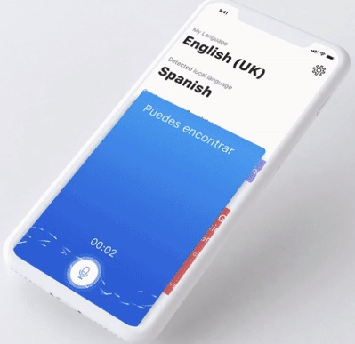
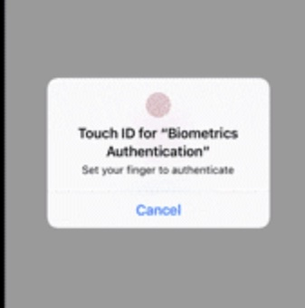

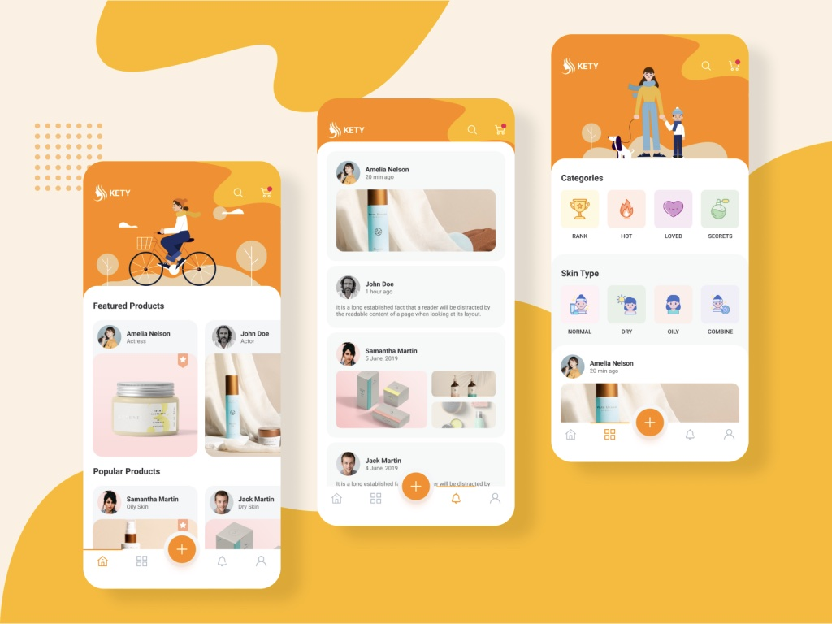
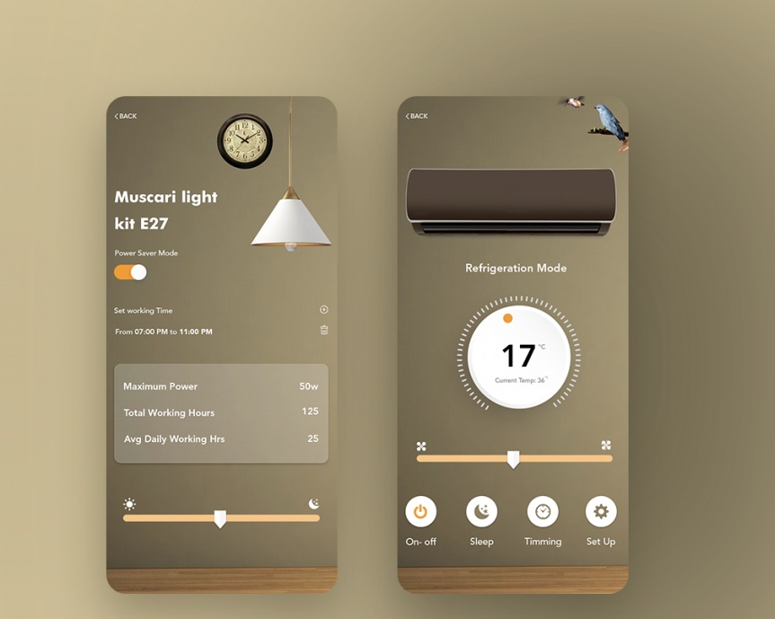
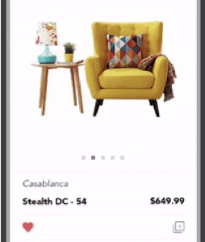
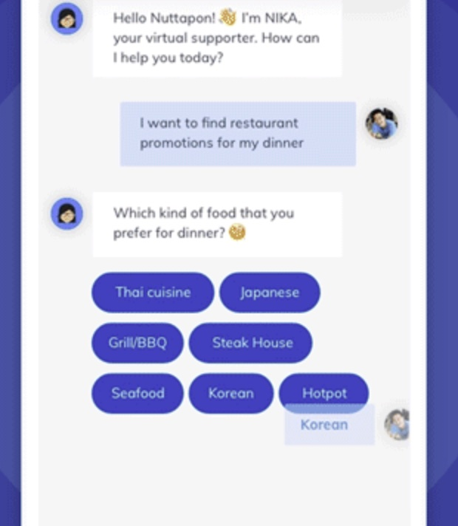

Mobile UI UX Design Trends for 2024
Improved Personalization
Rounded Corners
Convenient Voice Interaction
Password-less Login
Advanced Animation
Gradient
AR/VR
Chatbots UI Design

